Slide 1
Heart Attack Analysis
By: JinWei Loh, Tom Liu

Slide 2
About the Data
Age : Age of the patient
Sex : Sex of the patient
exang: exercise induced angina (1 = yes; 0 = no)
ca: number of major vessels (0-3)
cp : Chest Pain type chest pain type
Value 1: typical angina
Value 2: atypical angina
Value 3: non-anginal pain
Value 4: asymptomatic
trtbps : resting blood pressure (in mm Hg)

Slide 3
About the Data
chol : cholestoral in mg/dl fetched via BMI sensor
fbs : (fasting blood sugar > 120 mg/dl) (1 = true; 0 = false)
rest_ecg : resting electrocardiographic results
Value 0: normal
Value 1: having ST-T wave abnormality (T wave inversions and/or ST elevation or depression of > 0.05 mV)
Value 2: showing probable or definite left ventricular hypertrophy by Estes' criteria
thalach : maximum heart rate achieved
target : 0= less chance of heart attack 1= more chance of heart attack

Slide 4
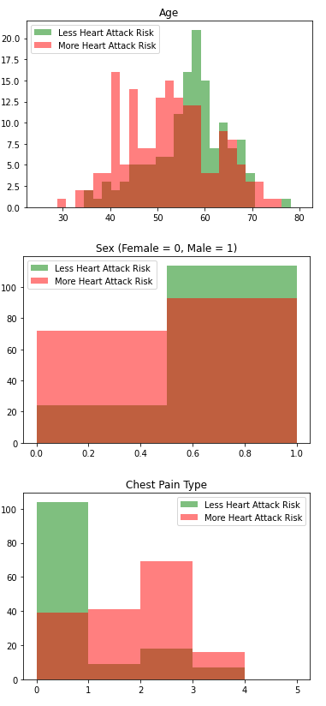
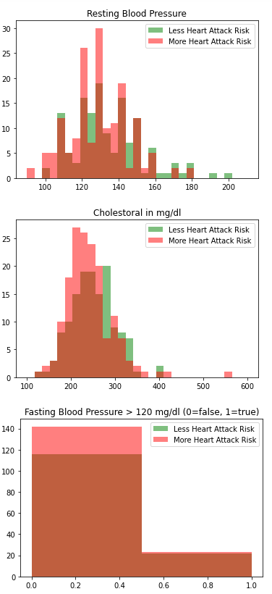
Correlation to Output

Slide 5
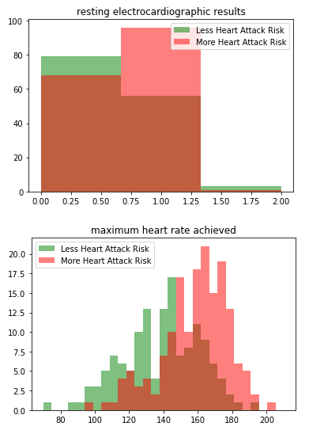
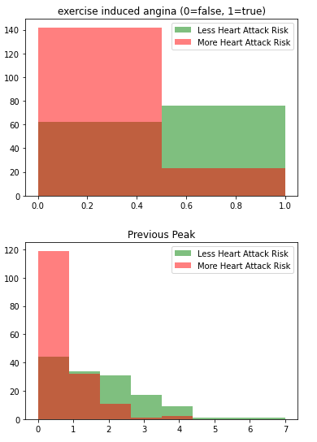
Correlation to Output

Slide 6
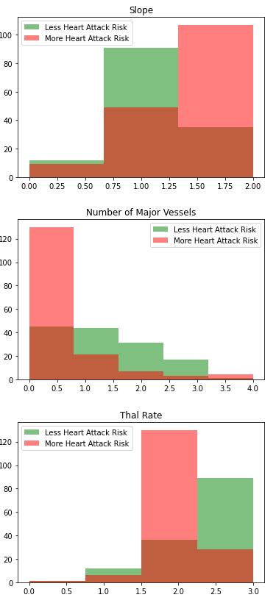
Correlation to Output

Slide 7
Supervised Analysis

Slide 8
Linear Regression

Slide 9
Linear Regression

Slide 10
SVM

Slide 11
SVM

Slide 12
Neural Networks

Slide 13
Neural Networks

Slide 14
Resuls

Slide 15
Results

Slide 16
Resources

